Slide 1
Evaluating the value of research-by-consortium
Mark David Lim, PhD
2014 Science of Team Science
August 6, 2014

Slide 2
Drug discovery is complex
Drug discovery
Preclinical
Clinical trials
Market surveillance
5-10K compounds
1 drug
Biomarkers:
Disease subtype/stage
Drug efficacy
Safety/toxicity
Cell assays / animal models
Clinical trial methodology
Data standards/interoperability
Standardized tools = added efficiency

Slide 3

research-by-consortium
Shared scientific challenge
Widely-usable tool
Virtual team to create / validate

Slide 4
research-by-consortium
Independent
Temporary association of researchers that share resources and effort for a common objective.
Consortia integrate multiple types of knowledge, data from multiple sources, and align different interests.
Consortium
Academia / Clinical
Patient groups
Government
Industry
Notes:
Temporary partnerships.

Slide 5
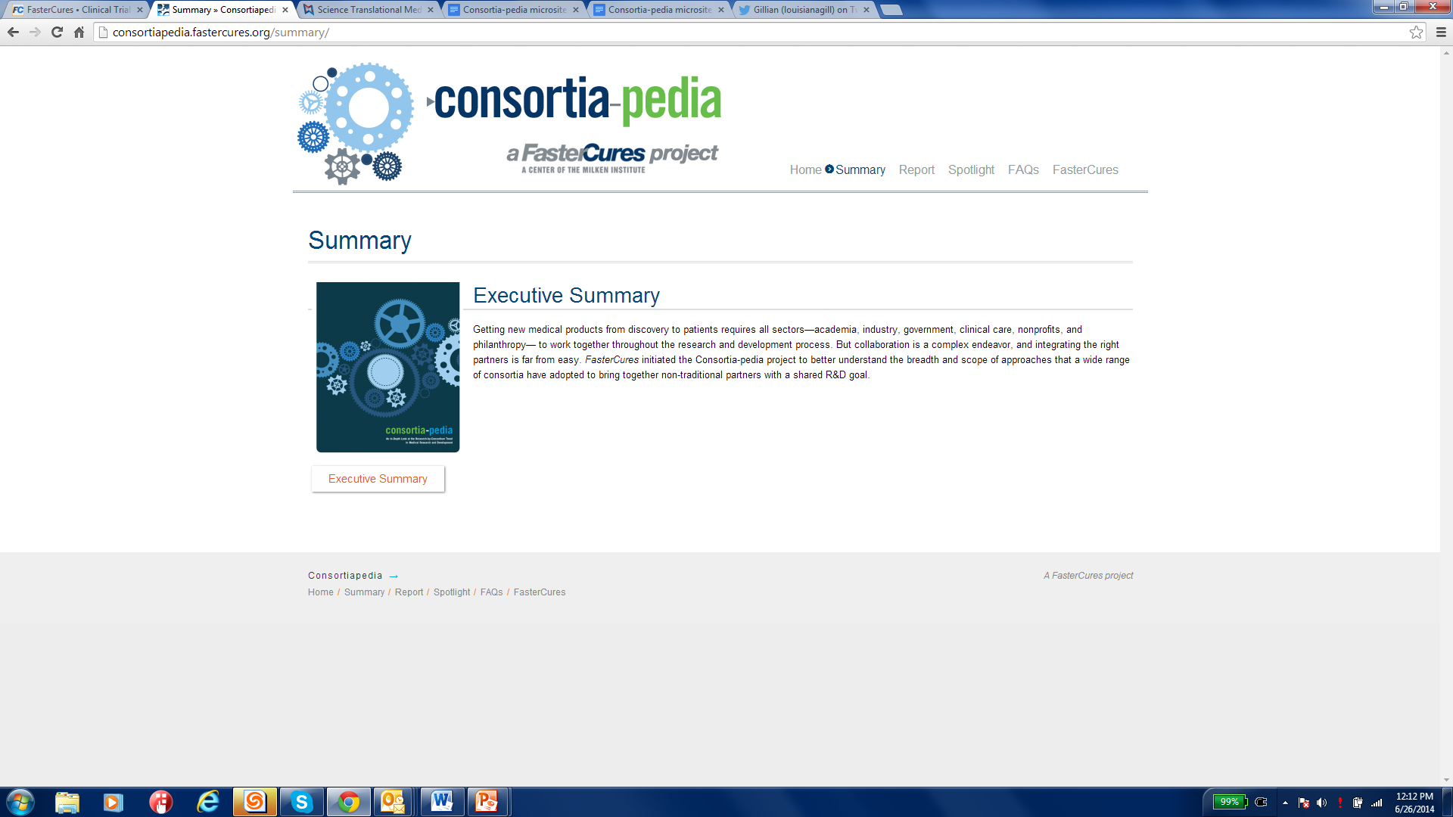

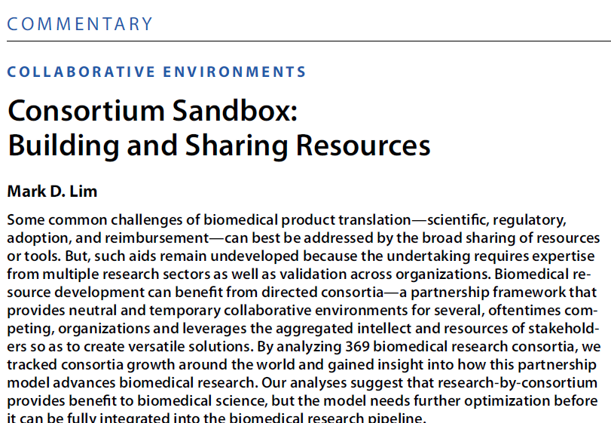
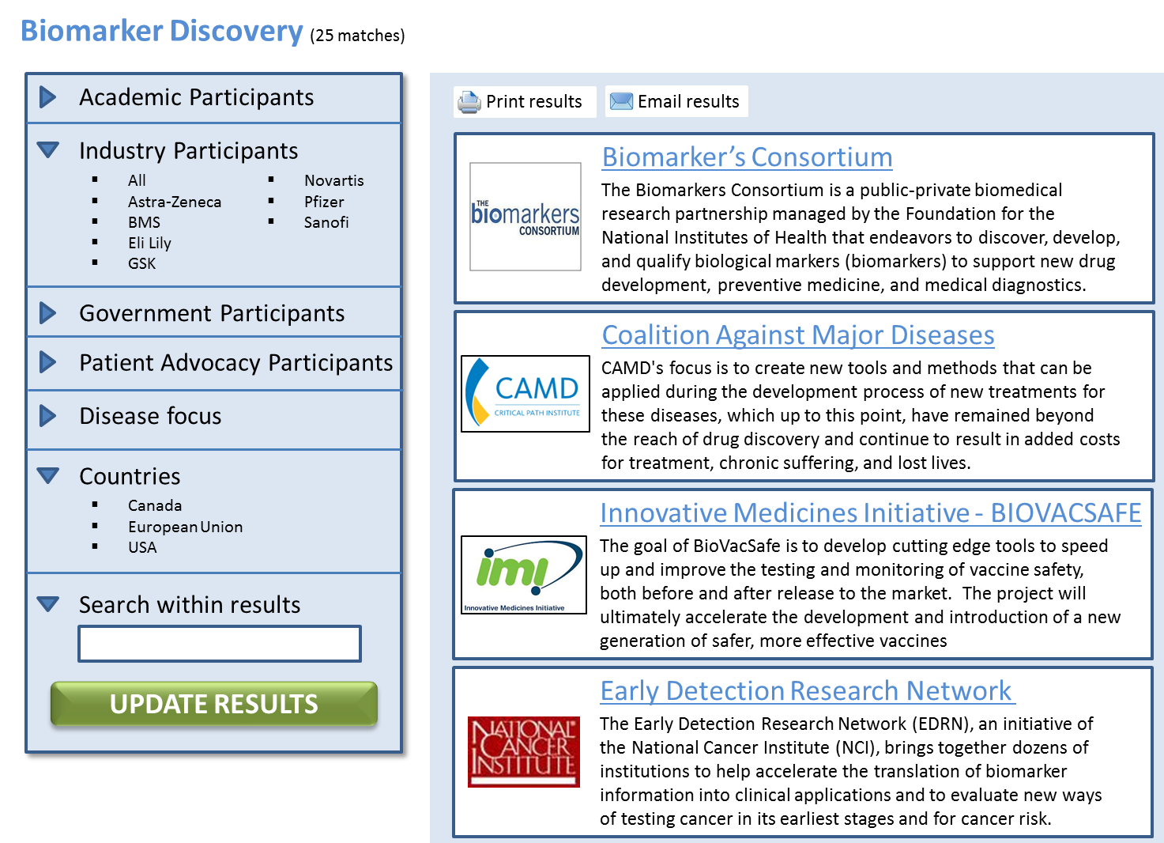
consortiapedia.fastercures.org
Operational Framework
Landscape
Database
Sci. Trans. Medicine, June 2014 http://bit.ly/STMConsortia
Planned release: end of 2014
Mission/governance
Financing
Data-sharing
Intellectual property
and others…
369 consortia
Disease focus
Types of tools
Where and who
Why
Consortium-provided content
Cross-comparison of consortia
Point-of-contact

Slide 6
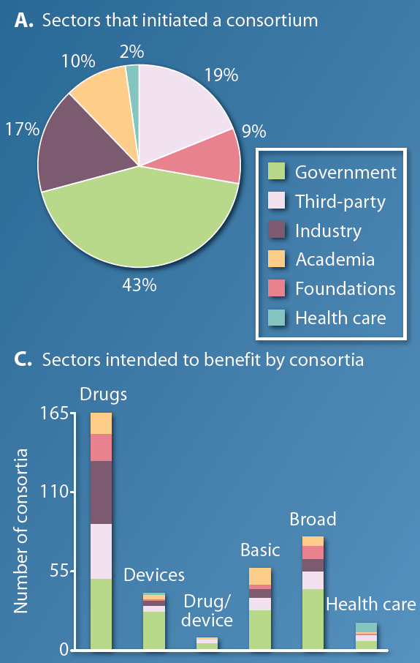
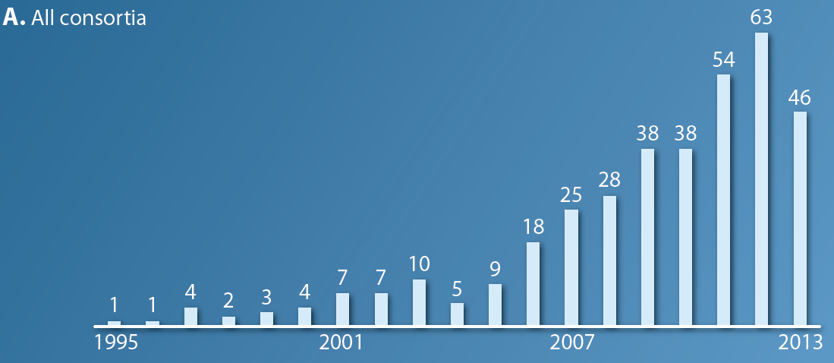
Who and what
Sci. Trans. Medicine, June 2014 http://bit.ly/STMConsortia

Slide 7
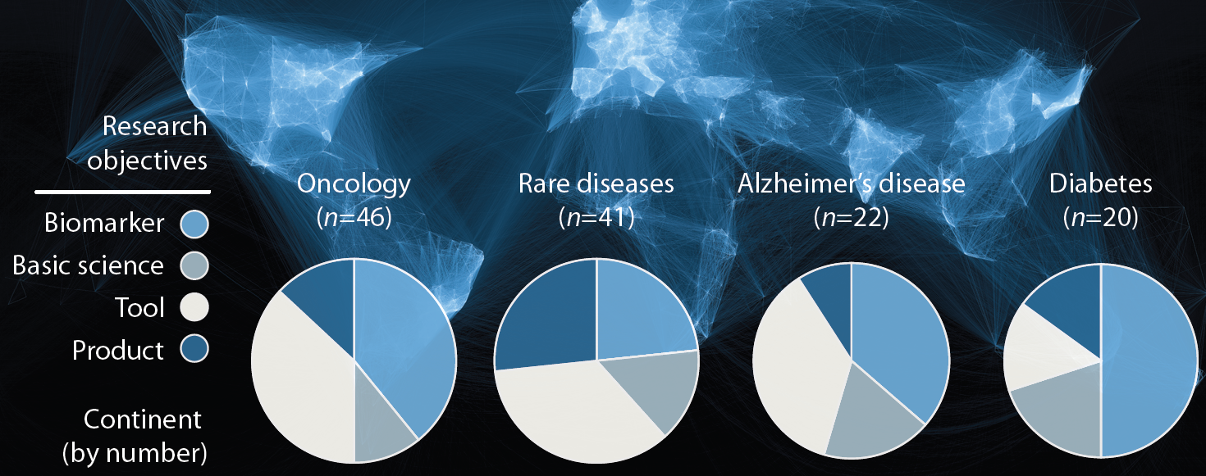



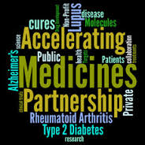
More than half focused on disease/condition
AgedBrainSYSBIO
Sharing comparator arm data from clinical trials
Research assays, animal models
Age-associated pathways
Genomic/clinical databaseT2D patients
Sci. Trans. Medicine, June 2014 http://bit.ly/STMConsortia

Slide 8






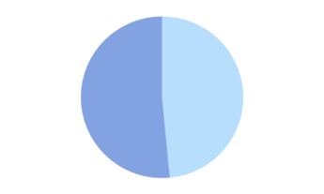

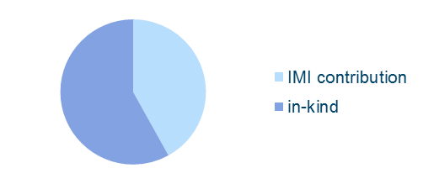



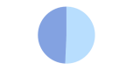
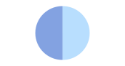



Breadth-of-scale: Innovative Medicines Initiative
€ 14 910 397
Relative effectiveness
€ 756 906 619
Infectious diseases - 39%
€ 18 118 249
Drug kinetics
€ 20 462 255
Drug delivery
€1 952 573 292
€ 30 531 192 Sustainable chemistry
€ 213 636 872
Drug discovery - 11%
€ 38 994 284
Education and training
€ 186 102 324
Brain disorders - 10 %
IMI funding
€ 39 901 138
Lung diseases
Corporate contribution
€ 118 189 462
Metabolic disorders - 6%
€ 49 310 000
Geriatrics
€ 116 287 312
Drug safety - 6%
€ 55 930 954
Biologicals
€ 76 872 548
Stem cells - 4%
€ 68 069 432
Inflammatory disorders
€ 74 345 401
Data management 4%
€ 74 004 854
Cancer
IMI Report: May 2014 Highlights

Slide 9
Consortium lifespan: 5 - 6 years
| 1 year | 2 - 3 years | 1 year |
Mid-stream
Project execution
Milestones
Wind down
Ramp up
Deliverables
Licensing/IP
Dissemination
Closure
Inception
Project launch
Team culture
Infrastructure
Data management
Licensing/IP
Dissemination
Royalties
Scientific challenge
Sponsor engagement
Governance
Agreements
Tool concept
Engaging tool-builders
Project plan

Slide 10
Evaluation = Support
| 1 year | 2 - 3 years | 1 year |
Mid-stream
Wind down
Ramp up
Closure
Inception
Financial and in-kind commitment
Monitoring & Evaluation
Steering Committee
Board of Directors

Slide 11
Complex virtual relationships
Oversight
Board of directors
Steering committee
Management
President / Executive director
Project manager
Project Team
Project manager
Scientific team

Slide 12





Many formal evaluations
Steering Committee
Board of Directors
Sponsors
Consortium Staff
Research Team

Slide 13
Many informal evaluations
Steering Committee
Board of Directors
Sponsors
Consortium Staff
Research Team

Slide 14

Whose value-add?
Government | public health regulatory science | de-risk innovation economic growth
Industry | accelerate pipeline new therapeutic area access resources | de-risk innovation access intellectual capital
Academia | access resources opportunities for publications | training opportunities identify collaborators
Patient organizations | accelerate pipelines advance basic research | de-risk medical product development
Consortium researchers | simplify day jobs access resources | networking training / education

Slide 15
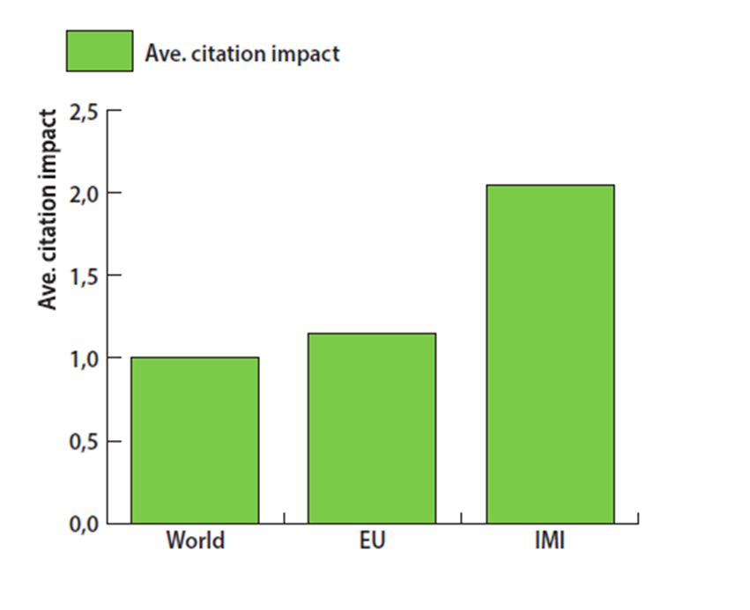
Bibliometrics is this all we can measure?
By the end of 2013, IMI projects had delivered over 600 scientific publications in over 300 journals
The citation index of papers from IMI projects is twice the world average, and higher than the EU average.
.
Data & analysis: Thomson Reuters (Custom Analytics & Engineered Solutions), 2013

Slide 16
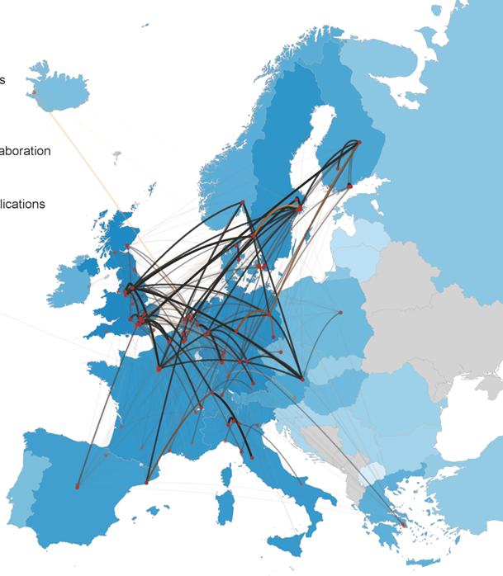
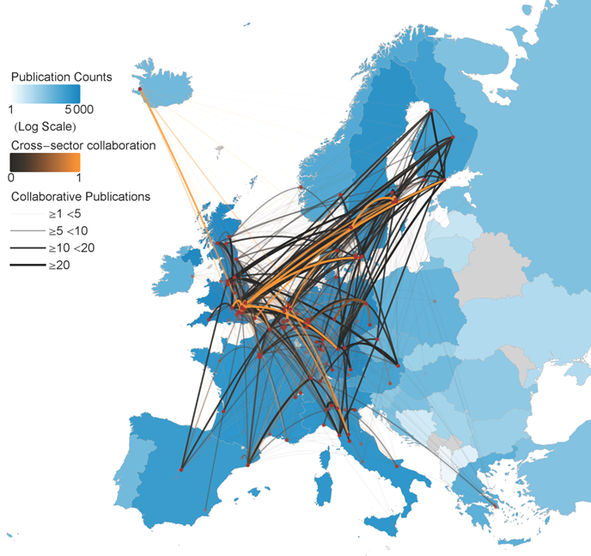
Bibliometrics and collaboration
Pre IMI funding award
Post IMI funding award
Data & analysis: Thomson Reuters (Custom Analytics & Engineered Solutions), 2013

Slide 17
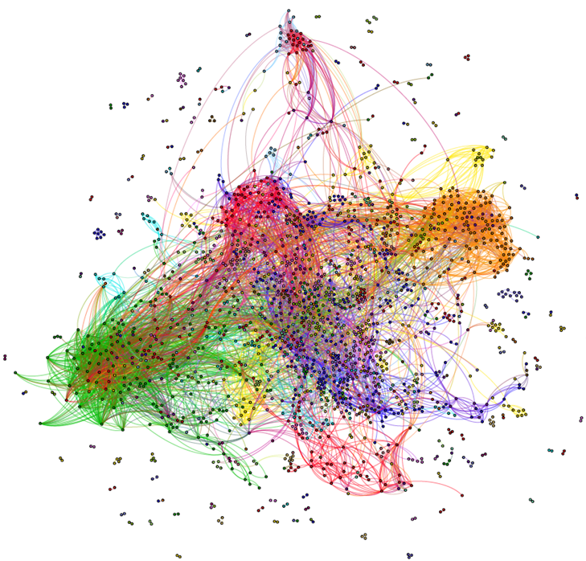
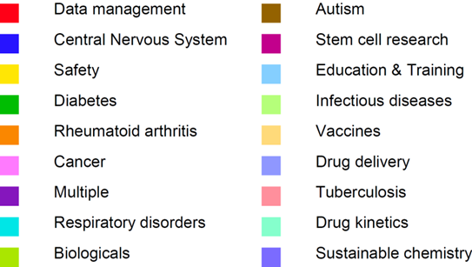
Collaborations – who / what
Co-authorship – 69%
Cross-sector collaboration – 42%
Cross-project collaboration – 37%
Cross-disease collaboration – 31%
IMI researcher networks by sector
Data & analysis: Thomson Reuters (Custom Analytics & Engineered Solutions), 2013

Slide 18



Complexities for evaluation
Not all consortium outputs are “publishable” – licenses, databases
Publications are retrospective, often-times at completion of project
Virtual collaborations - no dedicated laboratory/workspace
Bias: "Sexiness" of the science
Different stakeholders = different expectations Semi-committed teams - not their day jobs
Human capital - turnover, advancement
Numerous consortia, different operational models - cross comparison?
#

Slide 19


Defining metrics for value-add
Mid-stream analysis: Consortium on-track for deliverables?
- metrics: efficiency, project management, effective collaboration model
- indirect benefits: access resource/expertise
- users: stakeholders, consortium managers
- impact: financing, engagement of participants, additional support
Constraints:
- minimize bias
- scientific goals
- size/financing
- industry as first stakeholder
- generalizable to multiple "similar" consortia
Implementation:
- scope (pre-clinical vs. clinical, by type of output)
- metrics to evaluation
- cross-consortia measurements
?

Slide 20
Seeking insights & expertise consortiapedia.fastercures.org mlim@fastercures.org

